Slide 1

Data Vis Final Project
UFC
January 15, 2020
Quy, Justin, Rafael, Sunny

Slide 2

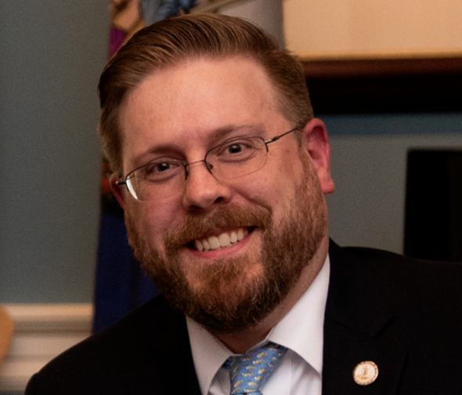

The Team

Slide 3

Project objective:
Utilize machine learning library to create a tool to predict outcome of UFC fights
Tools Used:
SciKit-Learn, Pandas, & Matplotlib

Slide 4





Approach
Step 1
Step 2
Step 3
Step 4
Identify relevant features to be used for ML training
Build via various models: Logistic Regression at first, then we explored Decision Tree & Random Forest
Clean dataset from Kaggle to convert all strings
Eliminate unnecessary variables & organize df
Ensure fit & accuracy of model by comparing predictions vs. actual results (test)
Rinse & Repeat Step 2 & Step 3 until accuracy is at an acceptable rate

Slide 5
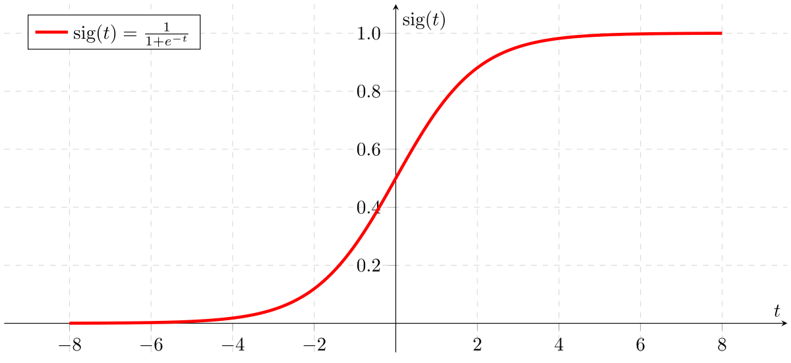
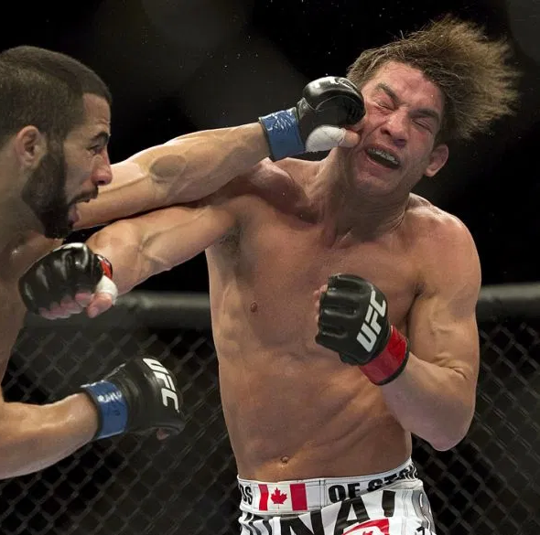
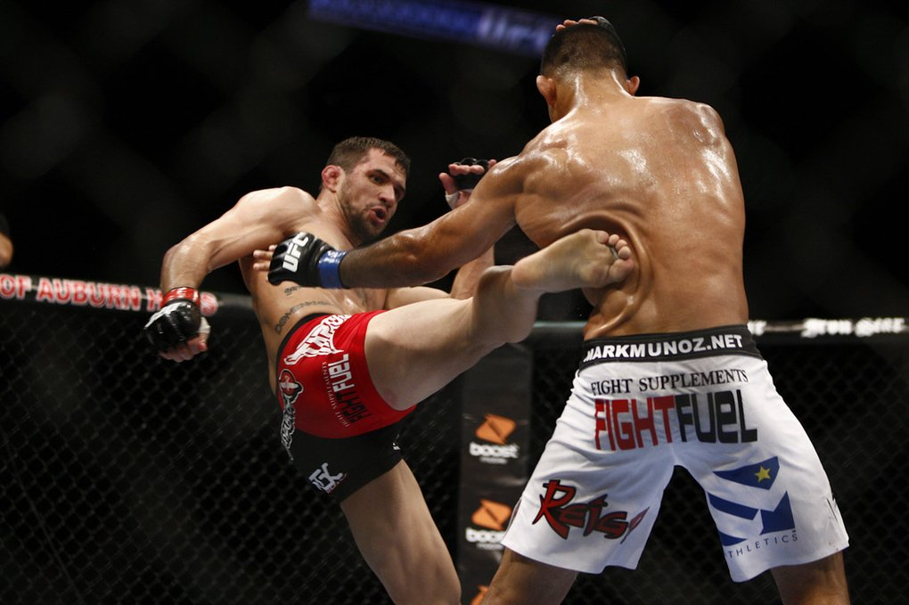
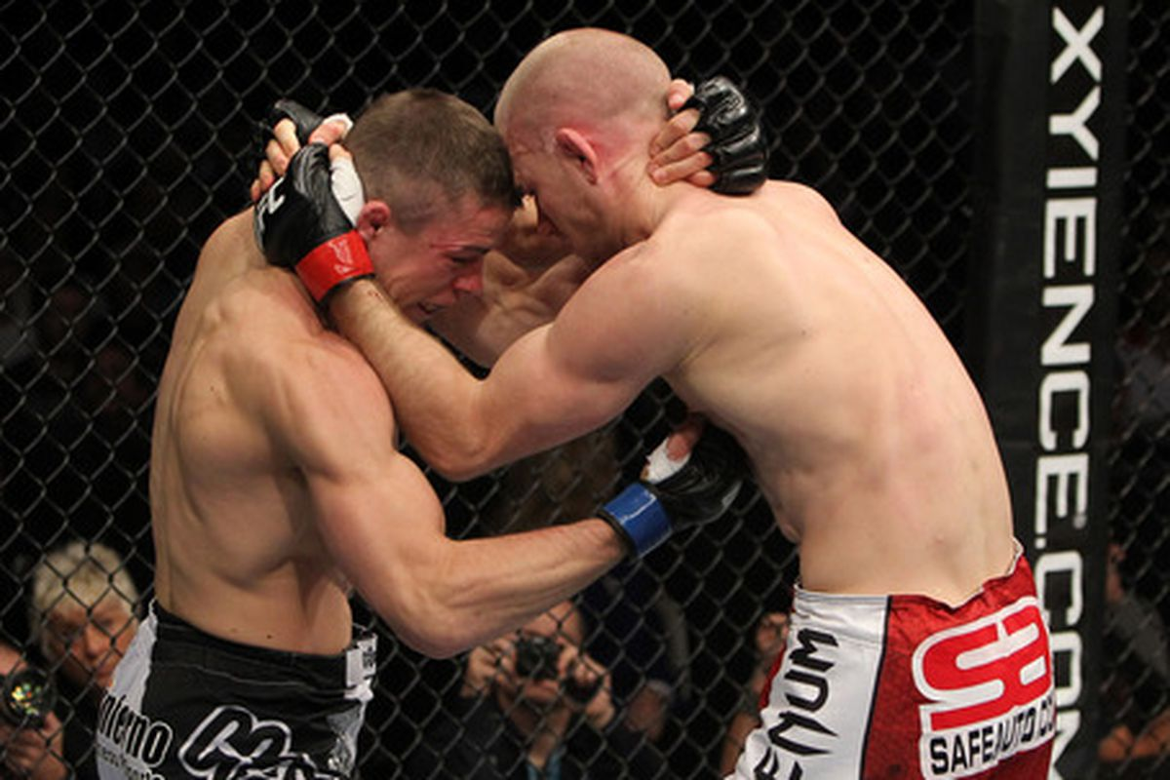
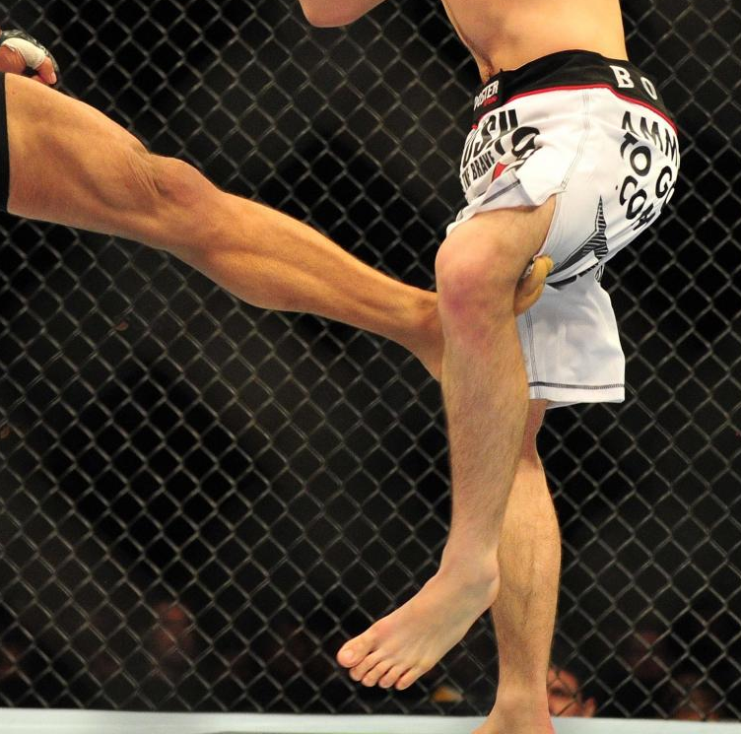
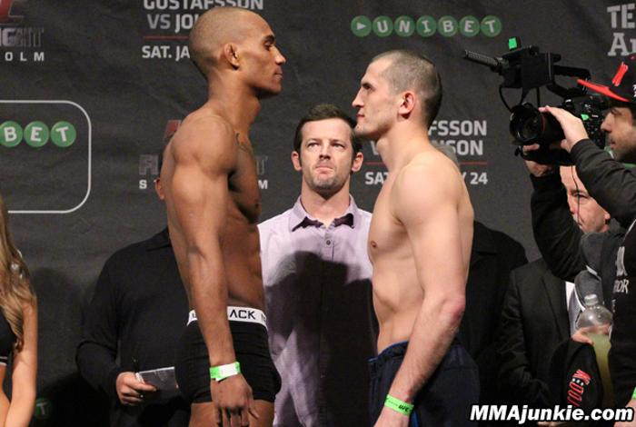
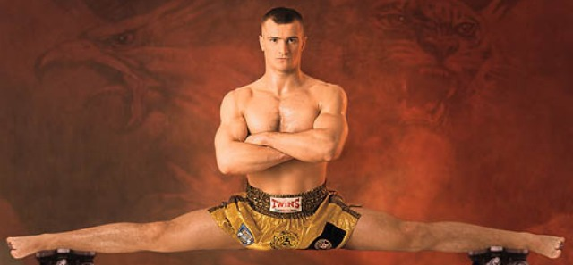
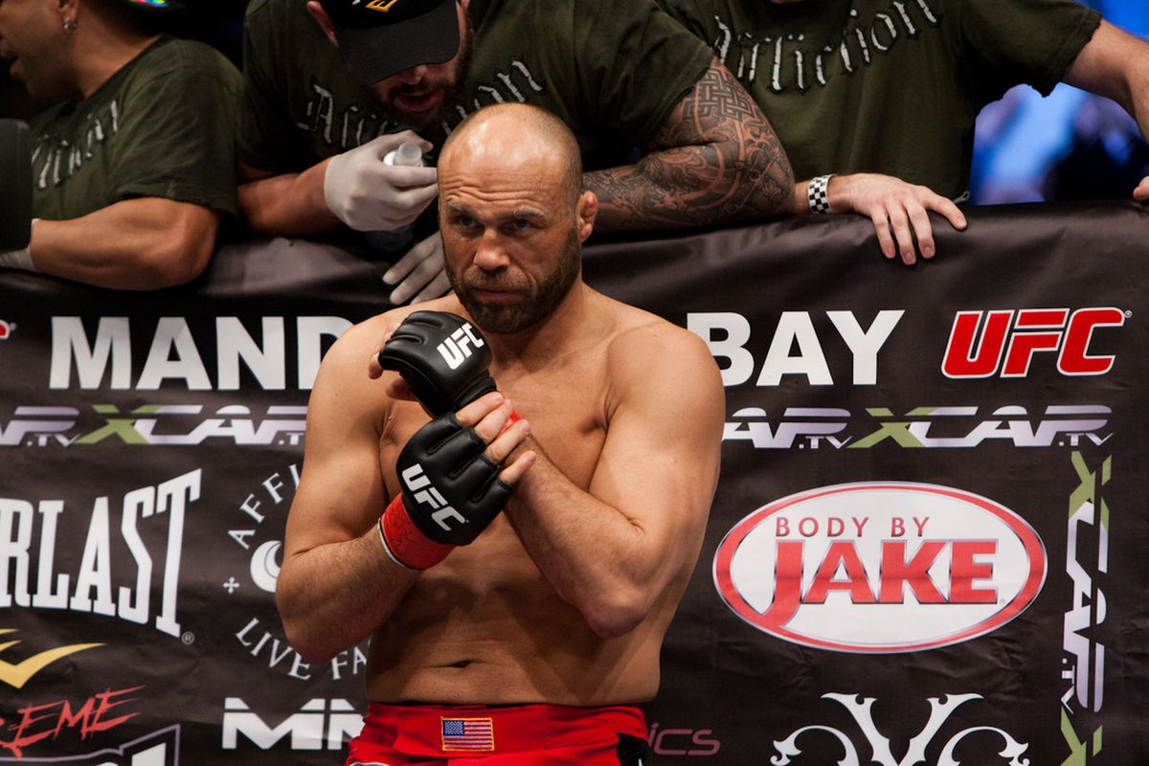
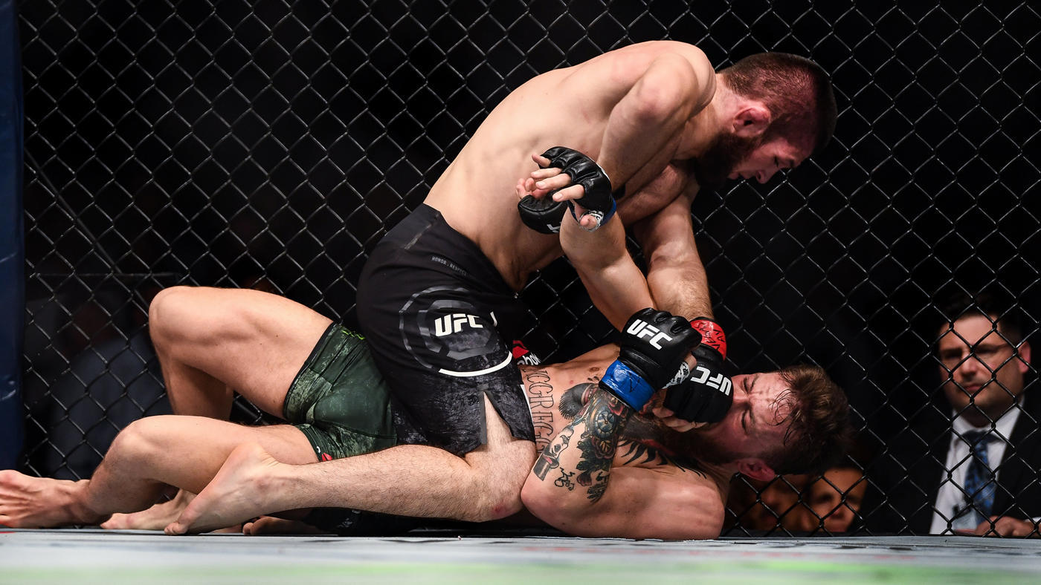
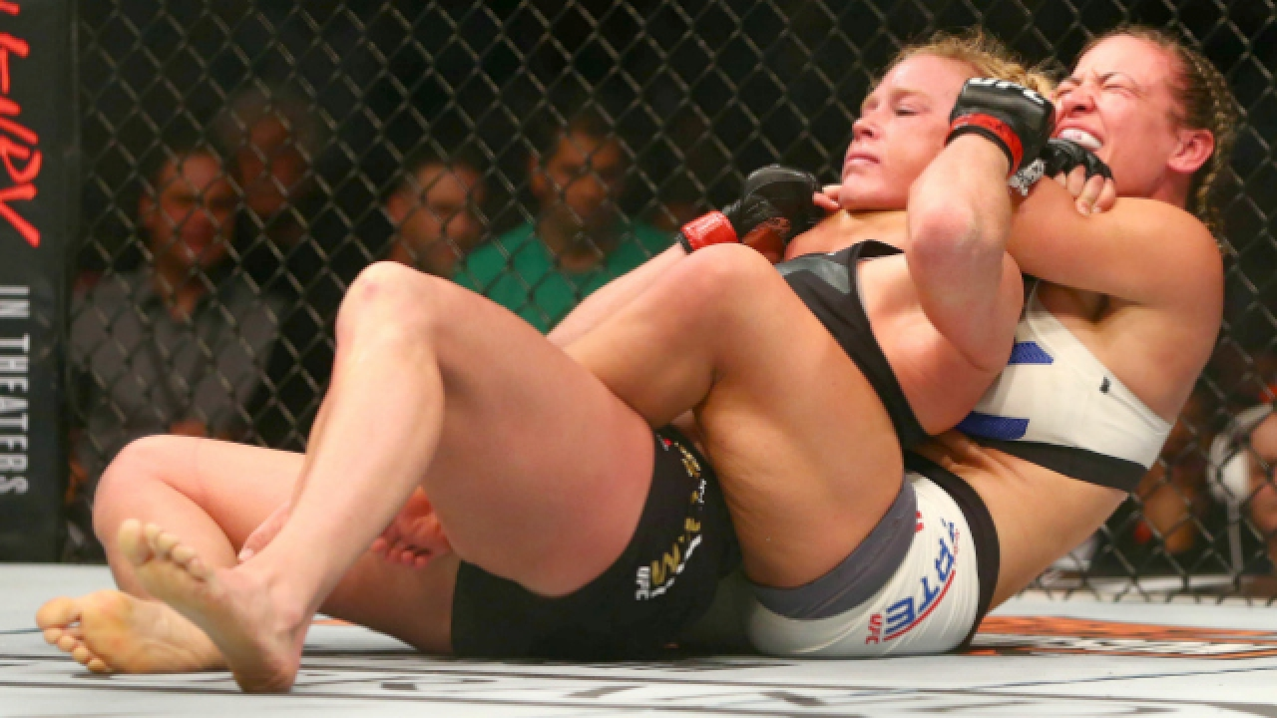
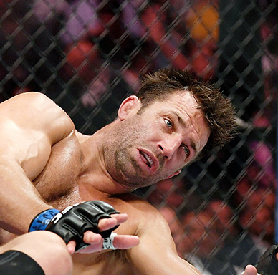
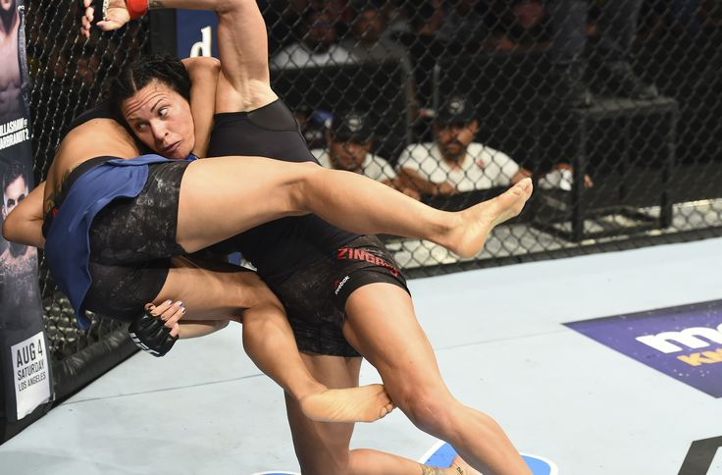
Our Model’s Features
Match Data
Fighter Data
Head Strikes
Body Strikes
Clinches
Leg Strikes
Height
Reach
Ground & Pounds
Age
Submissions
Knockdowns
Takedowns

Slide 6
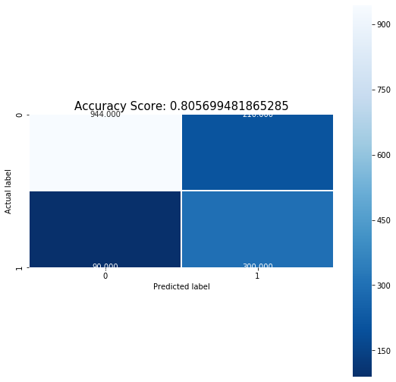
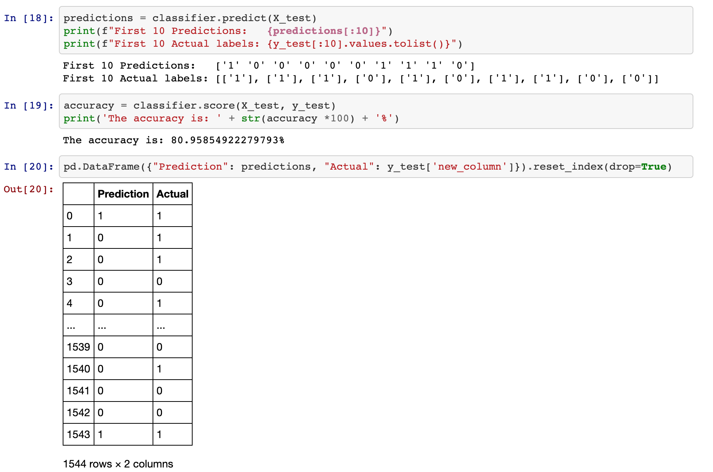

Calculating Accuracy
80% accuracy using Logistic Regression…
Can we do better?
*We converted results to represent:
1 = Red Side Win, 0 = Blue Side Win

Slide 7
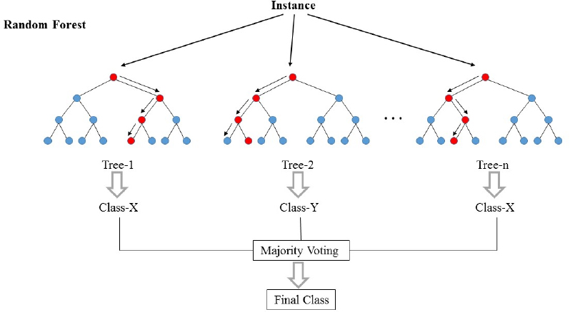
Our New Model’s Features
Match Data
Head Strikes
DIFFERENCE
Body Strikes
DIFFERENCE
Clinches
DIFFERENCE
Leg Strikes
DIFFERENCE
Ground & Pounds
DIFFERENCE
Submissions
DIFFERENCE
Knockdowns
DIFFERENCE
Takedowns
DIFFERENCE

Slide 8
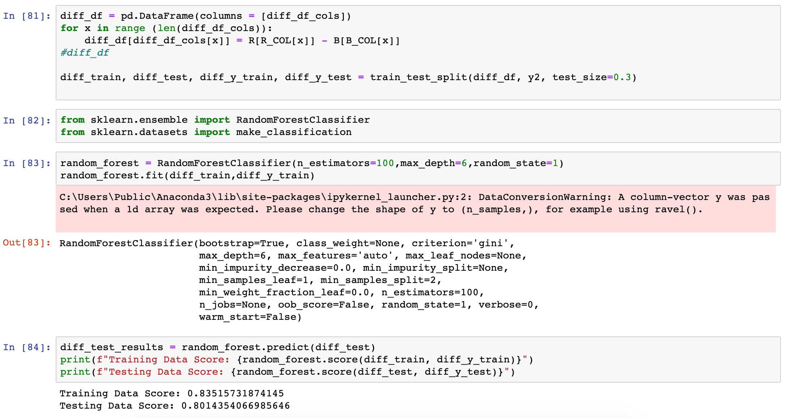
Final Accuracy
83%
Training Data
81%
Test Data
accuracy using “difference” features & Random Forest

Slide 9
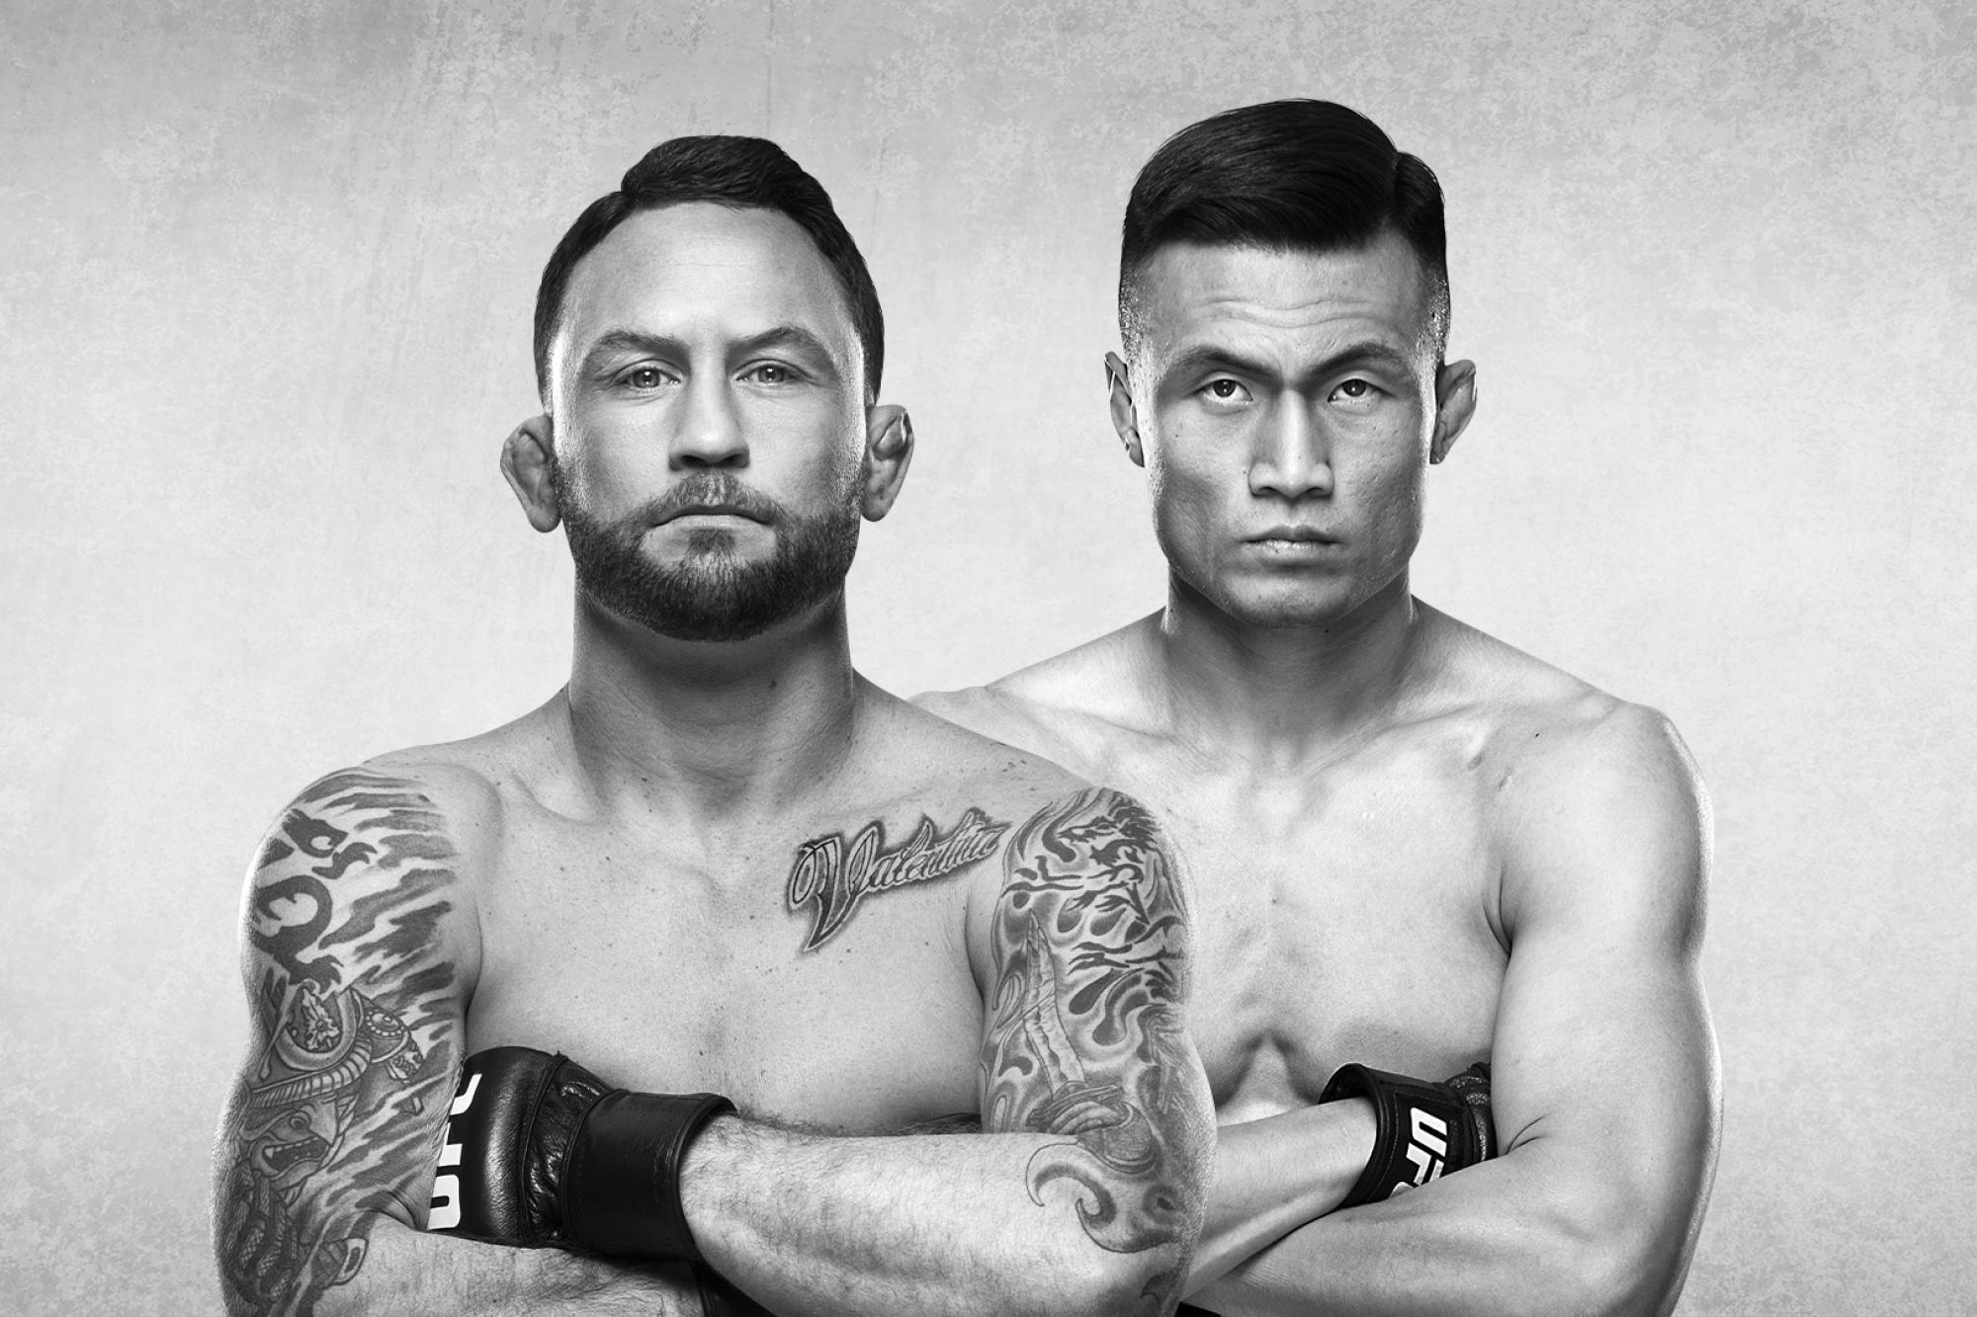
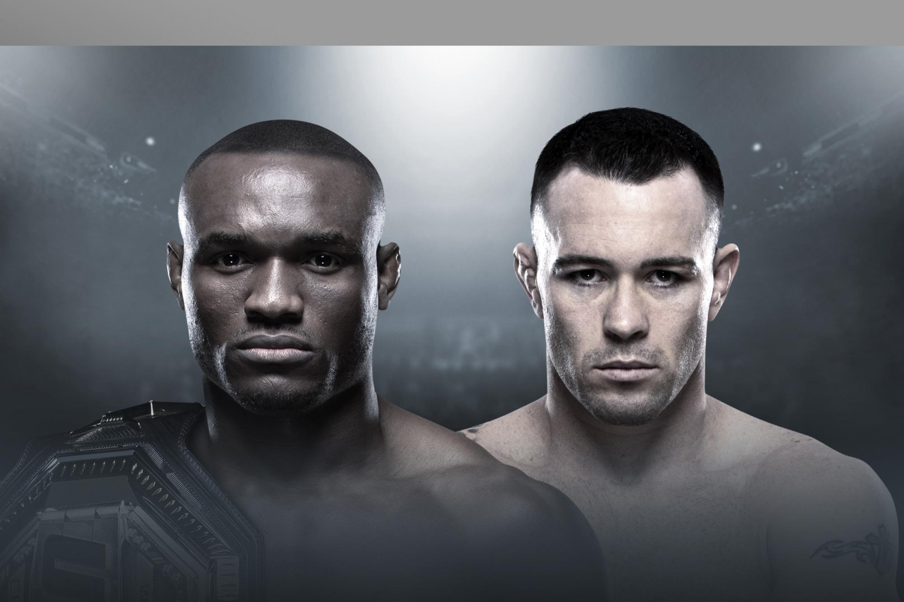
“Future” Predictions
Due to our Kaggle dataset ending on June of 2019, we decided to leverage our model to predict 2H 2019 matches…
Korean Zombie v. Frankie Edgar
UFC Fight Night 165
Our Model Prediction
Korean Zombie
Vegas Odds
Zombie -170
Edgar +140
Actual Result
Korean Zombie
(R1 KO/KTO)
Kamaru Usman v. Colby Covington
UFC 245
Our Model Prediction
Usman
Vegas Odds
Usman -175
Covington +145
Actual Result
Usman
(R5 KO/TKO)

Slide 10
Thank You!

